Slide 1
Sudoku Solver Visualizer
Submitted by:
Name: Shashi Bhushan Chawla
Registration no. 12216715

Slide 2
Introduction:
This project is developed using Java to tackle the classic puzzle game of Sudoku. Sudoku, a popular logic-based number placement puzzle, presents a 9x9 grid divided into 3x3 subgrids where the objective is to fill the grid with numbers from 1 to 9. Each row, column, and subgrid must contain all digits from 1 to 9 without repetition. Solving Sudoku puzzles can be both challenging and rewarding, often requiring a strategic approach and keen problem-solving skills. Our project aims to simplify and visualize the solving process by providing an intuitive interface where users can input unsolved puzzles and watch the solution unfold in real-time. Leveraging the backtracking algorithm, our visualizer not only finds the solution but also demonstrates the step-by-step process, making it easier for users to understand and learn the solving technique. Join us as we explore the features, functionality, and implementation of our Sudoku Solver Visualizer.

Slide 3
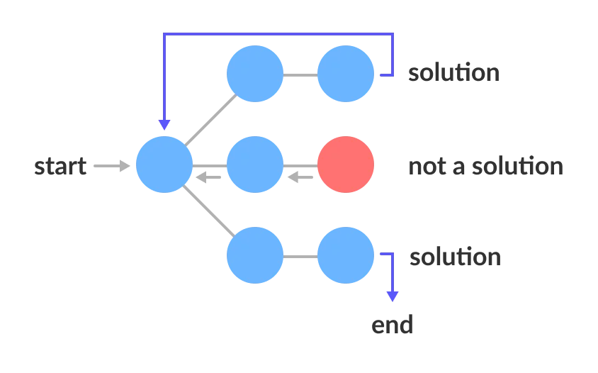
Algorithm used & Approach:
Algorithm Used : Backtracking
Backtracking is a method used to solve problems like Sudoku by trying different possibilities one at a time. If a possibility doesn't work, it goes back and tries another one. This way, it systematically explores all possible solutions until it finds the right one. It’s like finding a path in a maze by exploring each option and backtracking when hitting a dead end, ensuring a thorough and logical approach to solving the puzzle.

Slide 4
Approach:
Start with an unsolved Sudoku puzzle input by the user.
Use the backtracking algorithm to attempt placing numbers from 1 to 9 in each empty cell.
Check that each number placement does not violate Sudoku rules for rows, columns, and 3x3 subgrids.
If a placement is invalid, backtrack and try the next possible number.
Continue this process until the entire grid is correctly filled.
Visualize each step of the algorithm so users can see how the solution is reached.

Slide 5
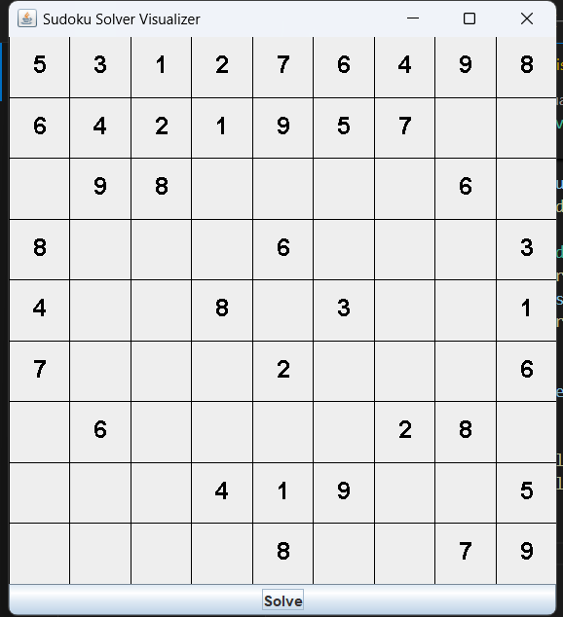
Sudoku Solver Visualizer :

Slide 6
Conclusions:
Visualizer project demonstrates a robust application of the backtracking algorithm to solve Sudoku puzzles effectively. By leveraging Java programming, we have created an intuitive interface where users can input puzzles and witness the step-by-step solution process in real-time. This project not only enhances understanding of algorithmic techniques but also provides a practical tool for Sudoku enthusiasts to enjoy and learn from. Moving forward, potential enhancements could include additional solving strategies and further optimizing the user interface for enhanced interactivity. We are excited about the possibilities this project opens for both educational purposes and practical problem-solving applications. Thank you for your attention.

